Slide 1
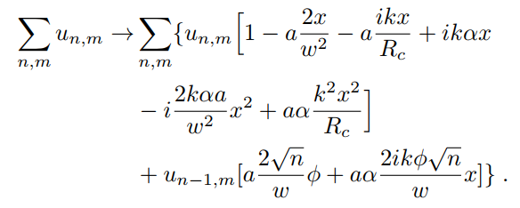
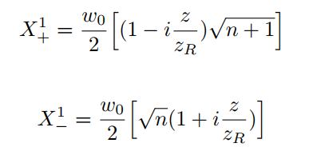
Mathematica
multivariate series expansion
Parse for Python
Split result for coordinate dependence (x,x^2…)
Apply coordinate transformation to HG modes
Long-arm RX TTL Symbolic Solver
1) Solve analytical coupling coefficients
Iterate over modes (n,m) of ‘tophat’
Calculate couplings and split again into modes (x-dep.)
Update mode coefficients (on-axis)
2) Evaluate coupling coefficients (hard part)
Integrate over PD for on axis modes (n,m) with Gaussian (0,0)
Factor coupling coefficients
Take arg’s for beat signal phases
3) Calculate signals (easy part)

Slide 2
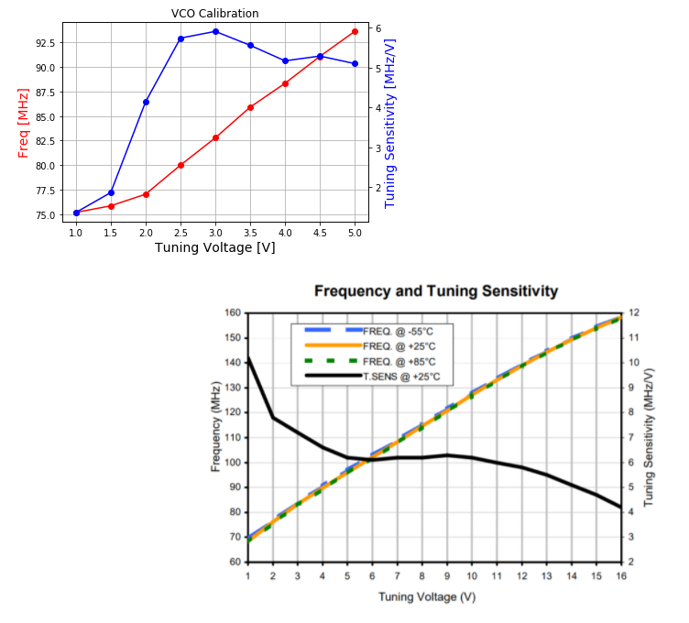
Lab VCO
Mini-Circuit Datasheet

